Slide 1
SBI - Identification & Optical character recognition (OCR) for Structured Documents
Sourabh Kumar Janghel

Slide 2
HELLO!
I am Sourabh Kumar Janghel
This Presentation contains detailed representation of the POC submitted at Techgig for SBI Hackathon .
You can find me at sourabh.kumar.janghel@outlook.com

Slide 3
Description Of Solution
1
Description of what the Team has tried to build

Slide 4
PROCESS
Upload document to azure
Detect Face from PDF’s using local model
Categorize extracted data into entities, structured and unstructured data
Identify signature using local custom model
Create a JSON output and save the response
Classify document using hashing
1
2
3
4
5
6
7
8
9
10
11
12
Identify document type (PDF/Image)
Detect Face from Azure for images
Extract data from Azure form recognizer either using the custom trained ones or a general one
Identify signature using azure data extracted
Mask Data for KYC’s identified documents
Upload the JSON to Azure DB

Slide 5
ROADMAP - CLASSIFICATION
Check if asset is a pdf document or an image
Use Hashing to get similar images from a pre-created hashing embedding from different form images
Process asset from Azure from recognizer and get Document type from it
1
3
5
2
4
6
Upload asset to AZURE containers
Get a hashing similarity score and document type
If model found trained on AZURE with good score we update our document classification from hashing.

Slide 6
ROADMAP - EXTRACTION
Upload the document to azure and get a url
Call azure for recognizer with the composed model id
If not call the general Form recognizer model to extract data
1
3
5
2
4
6
Check if asset is a pdf document or an image
Extract data if the document classification score is > 0.7
Create. A response by extracting entities, structured and unstructured data with signature validation.

Slide 7
ROADMAP – FACE DETECTION
Upload the document to azure and get a url
For Images Call Azure face detection to get the detected faces
For each page saved as image call the local custom model to detect face
1
3
5
2
4
6
Check if asset is a pdf document or an image
For PDF’s convert the pages into images and save it in a local directory
Clean the result to get the face detected and bounding boxes associated with it

Slide 8
ROADMAP – SIGNATURE DETECTION
Upload the document to azure and get a url
Detect Signature if present in the data
extracted from azure form recognizers
Compare the results
1
3
5
2
4
6
Check if asset is a pdf document or an image
Use Local custom model to also detect and extract signature
Save the signature detection field in response

Slide 9
ROADMAP – KYC MASKING
Upload the document to azure and get a url
Detect if the document is a KYC class
For a predefined list of entities to be masked for each KYC type create mask using bounding boxes
1
3
5
2
4
6
Check if asset is a pdf document or an image
For KYC detected documents get the recognized entities from azure form recognizers with their bounding boxes
Save the mask image

Slide 10
Architecture
2
High-level implementation / Solution diagram

Slide 11
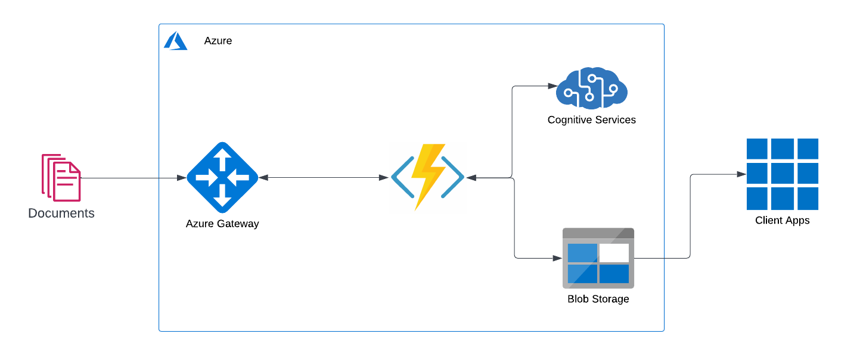

Slide 12
Tech Stack
3
Tools, Technology Stack (including the APIs consumed), and framework details

Slide 13
TECH STACK ANALYSIS
Tools
Python 3.9
APIs
Azure Functions
Azure Form Recognizer
Azure Face Detection
Azure Containers
Storage
Ghostscript
Poppler
Framework

Slide 14
Algorithms
4
The algorithms / machine learning models that have been used in the Hackathon prototype

Slide 15
USED Algorithms
ImageHash
retina-face
pdf2image
signature-detect
numpy
opencv-python
Pillow
imutils
tqdm
azure-formrecognizer
azure-computervision
azure-face
azure-storage-blob

Slide 16

A PICTURE IS WORTH A THOUSAND WORDS
A complex idea can be conveyed with just a single still image.
Namely making it possible to absorb large amounts of data quickly.

Slide 17
Output
5
Test cases and corresponding processed output file(s) along with the output time

Slide 18
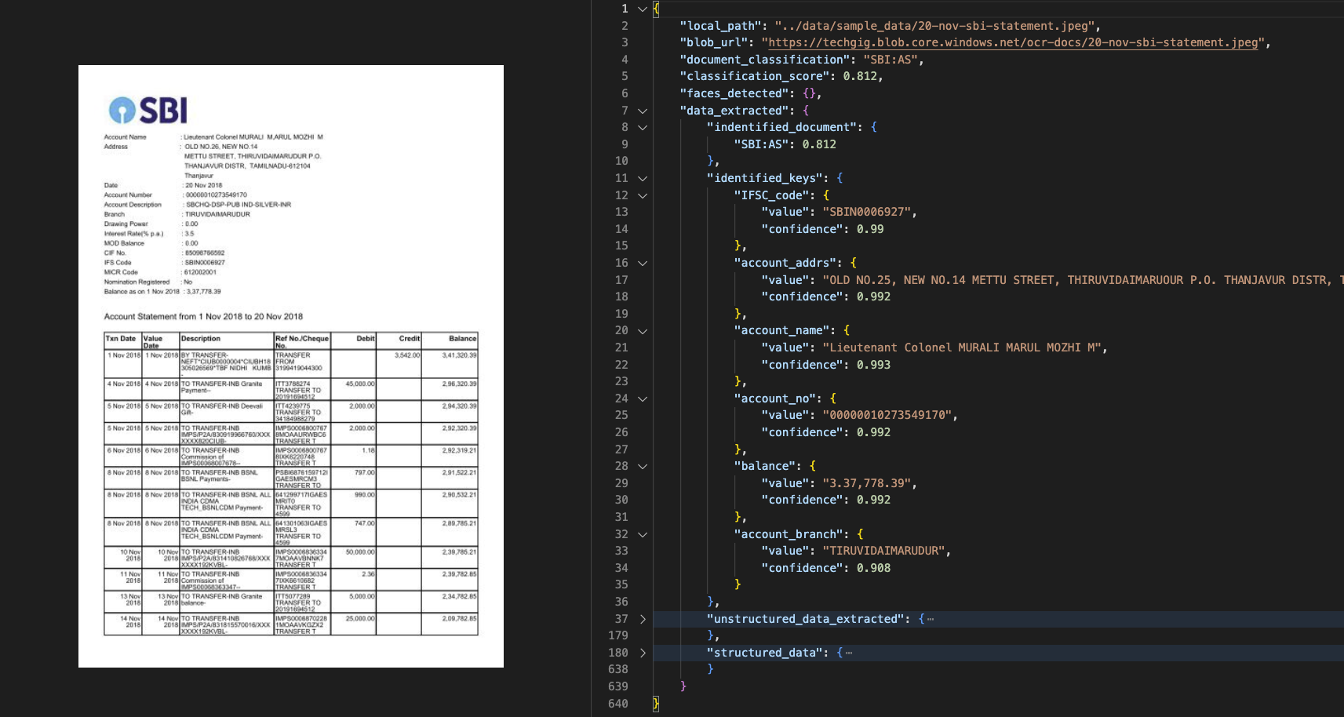
Classification

Slide 19
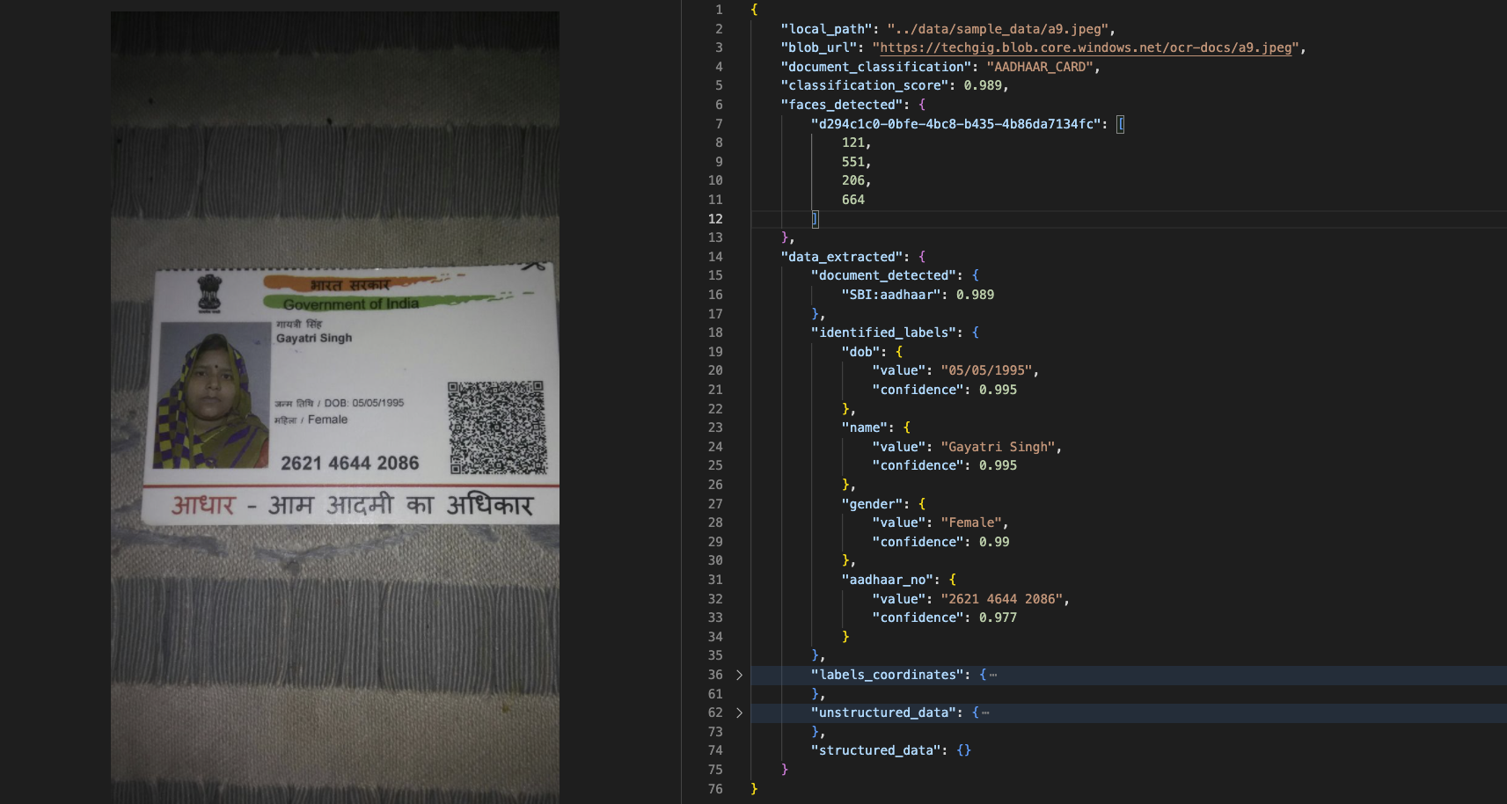
Classification

Slide 20
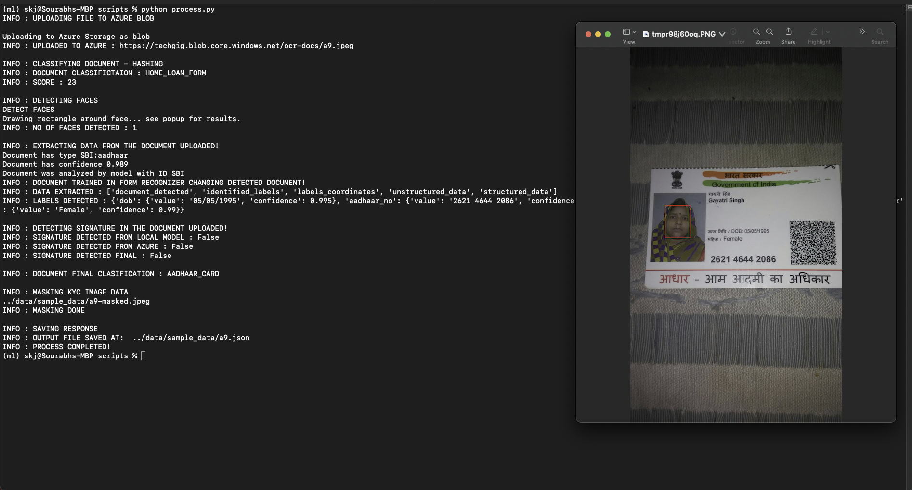
Face Detection

Slide 21
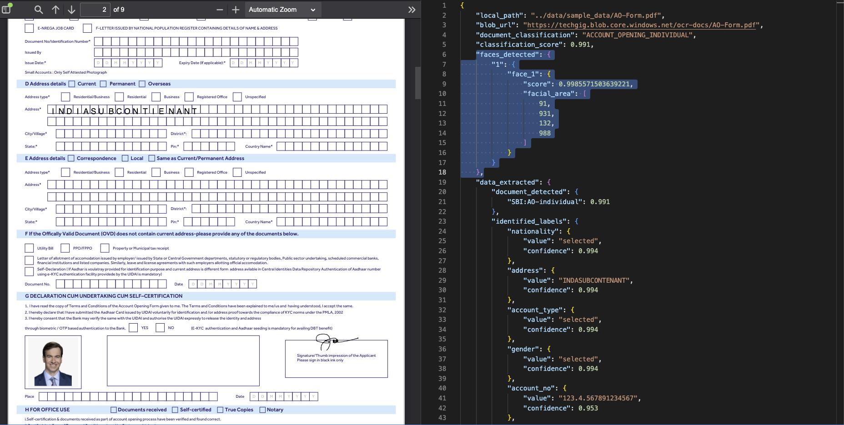
Face Detection

Slide 22
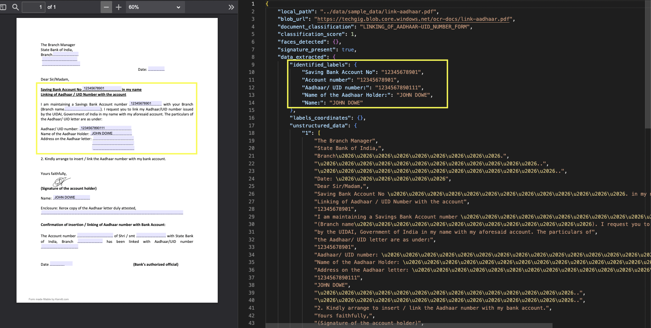
DATA EXTRACTION

Slide 23
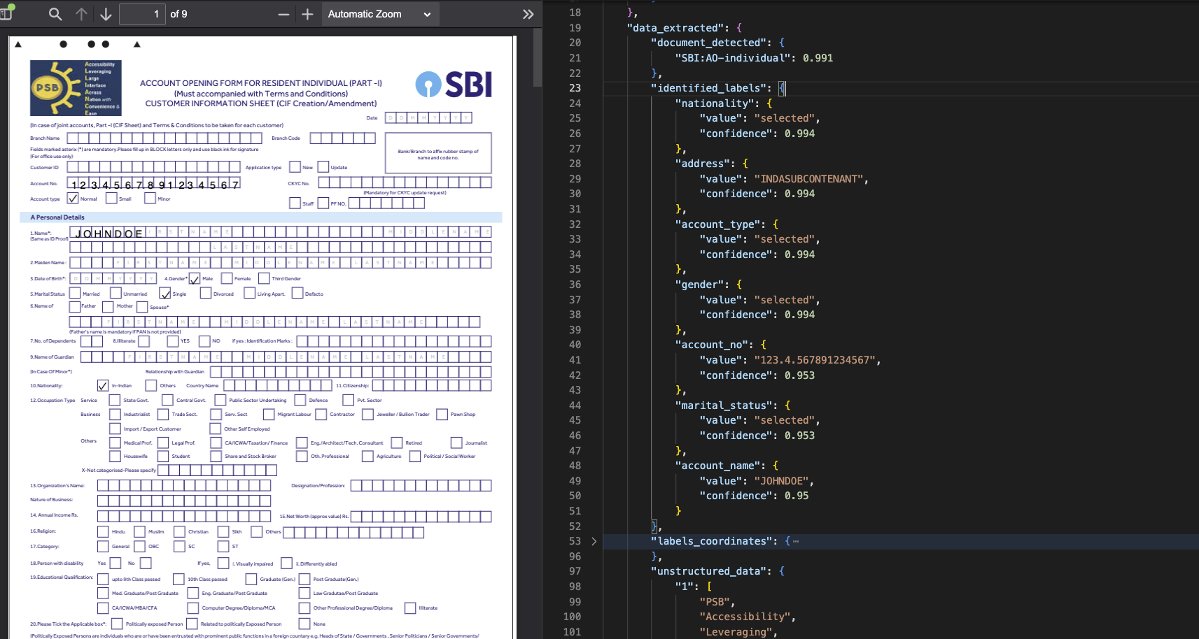
DATA EXTRACTION

Slide 24
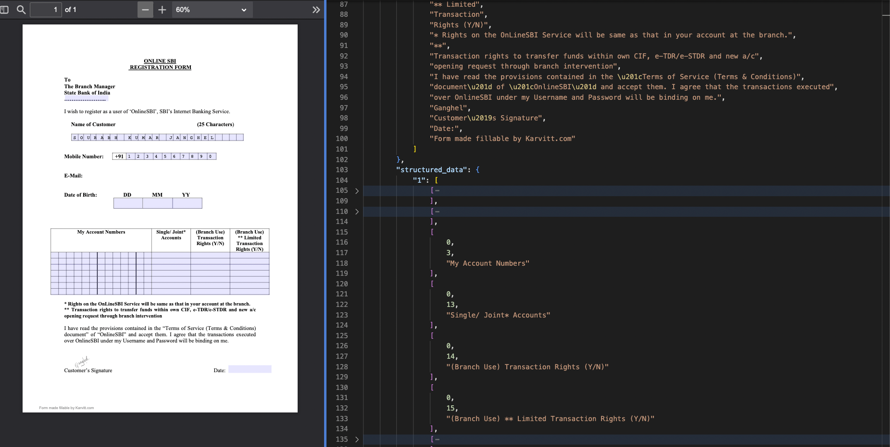
DATA EXTRACTION

Slide 25
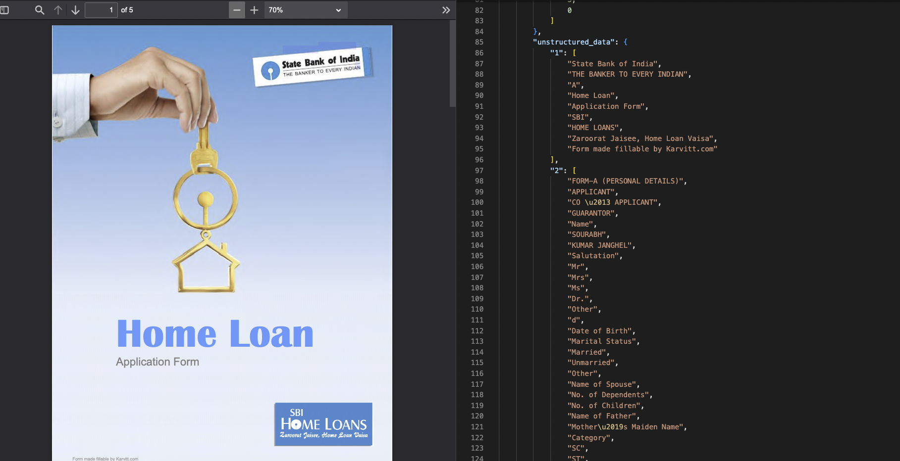
DATA EXTRACTION

Slide 26
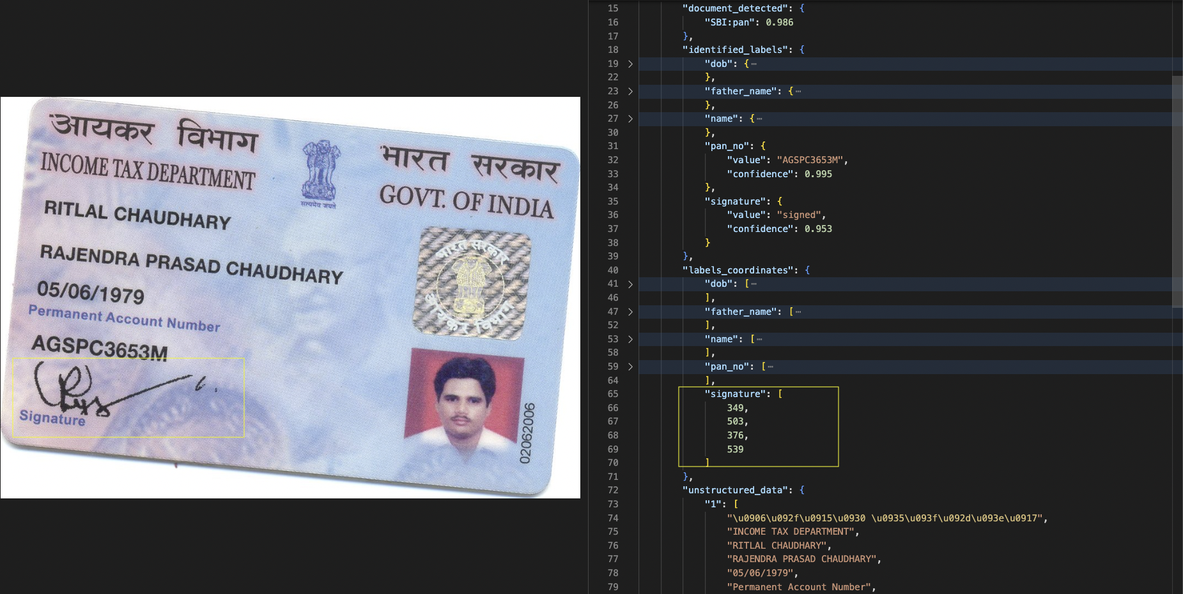
Signature Detection

Slide 27
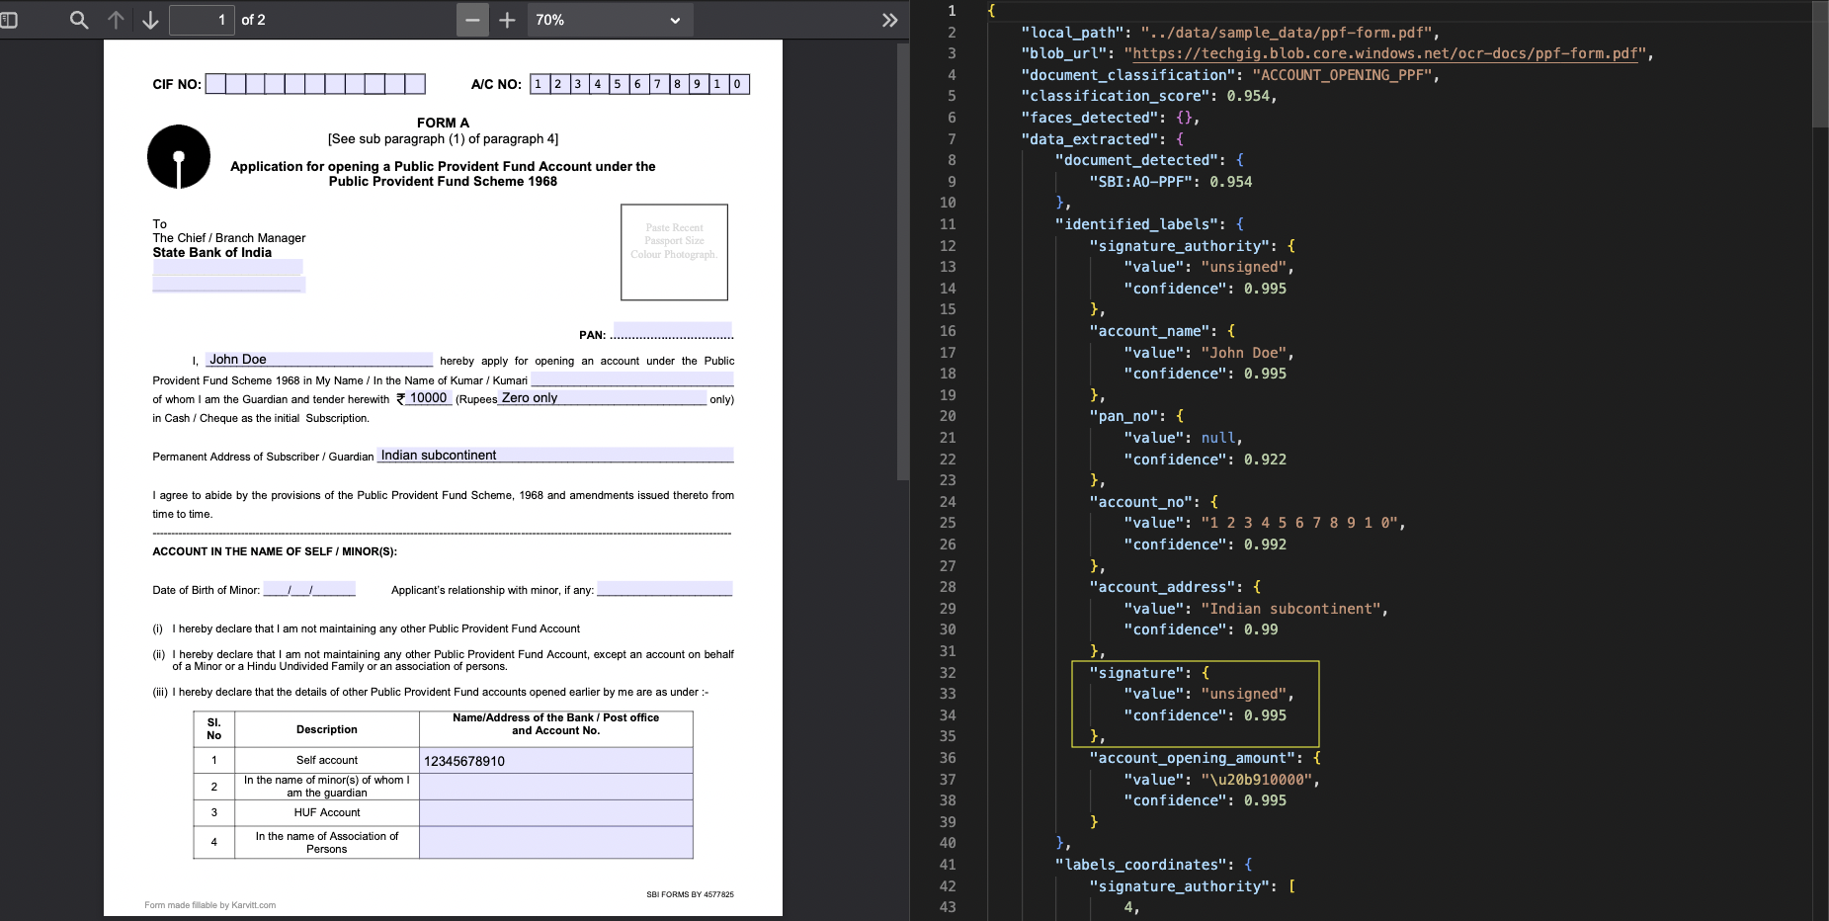
Signature Detection

Slide 28
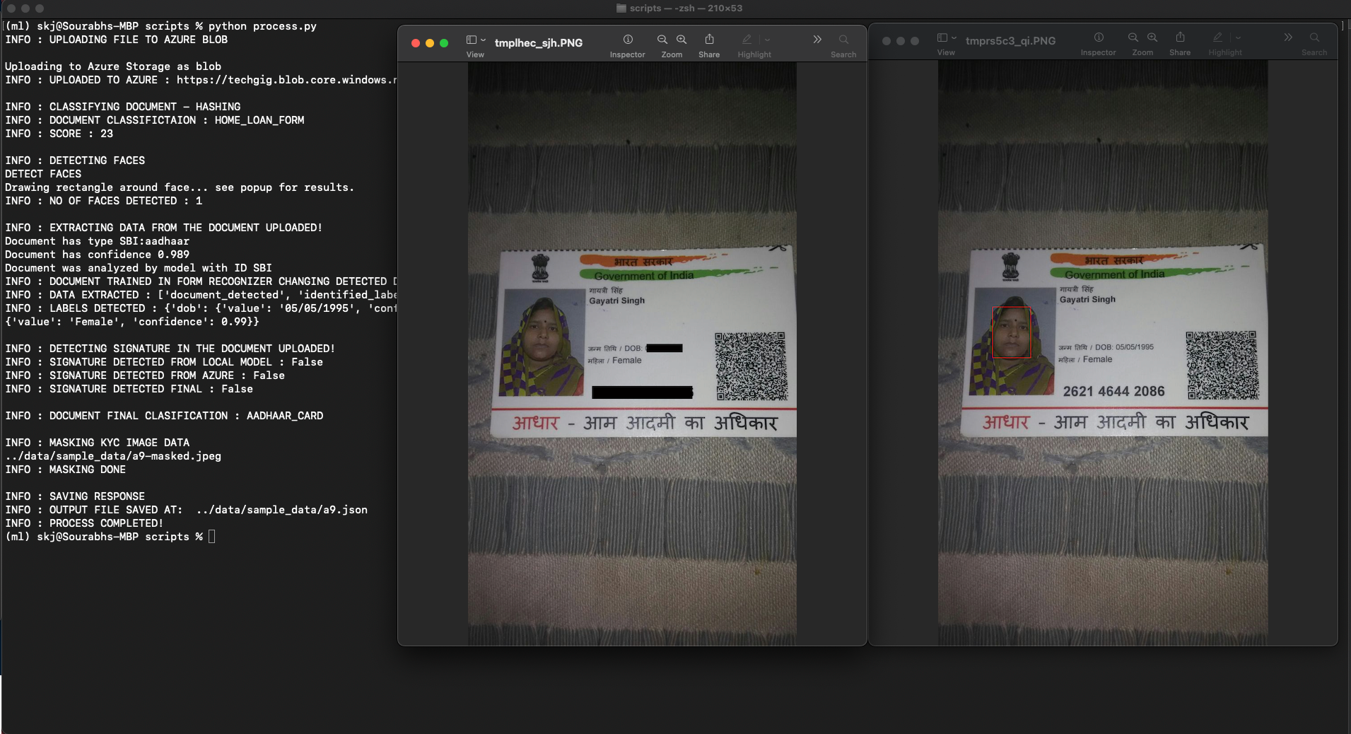
Masking

Slide 29
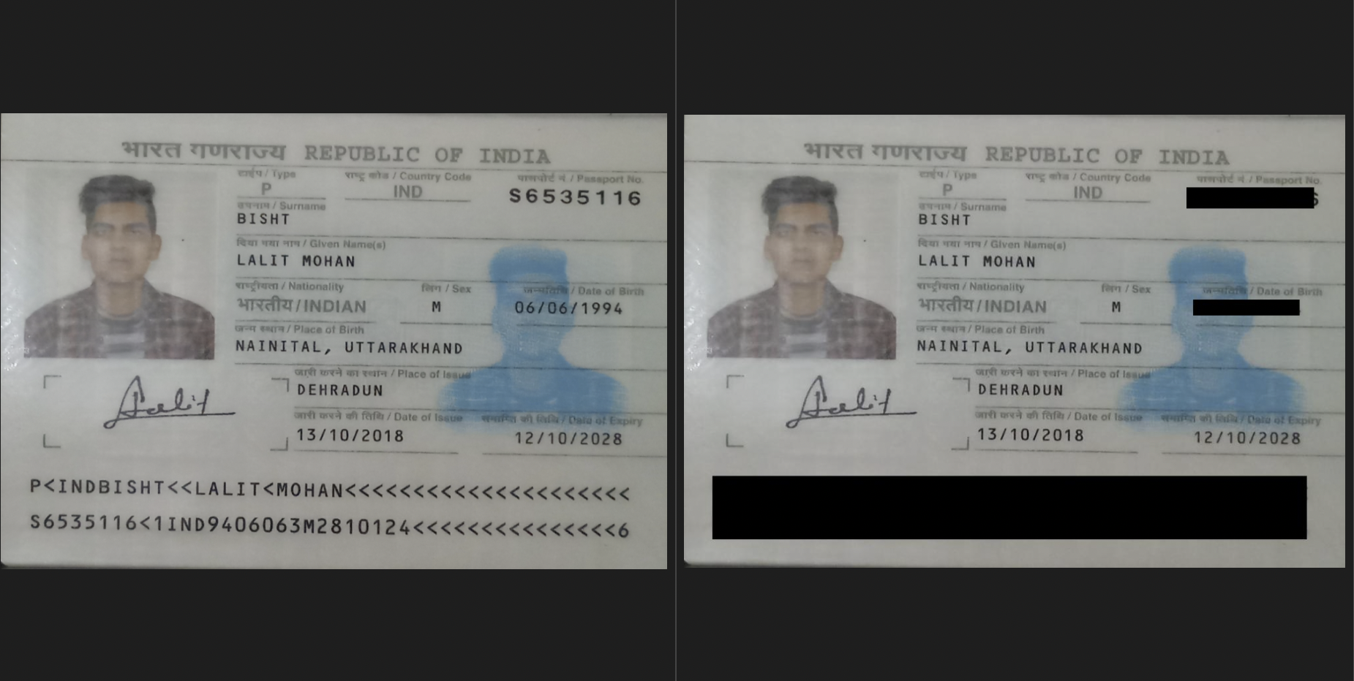
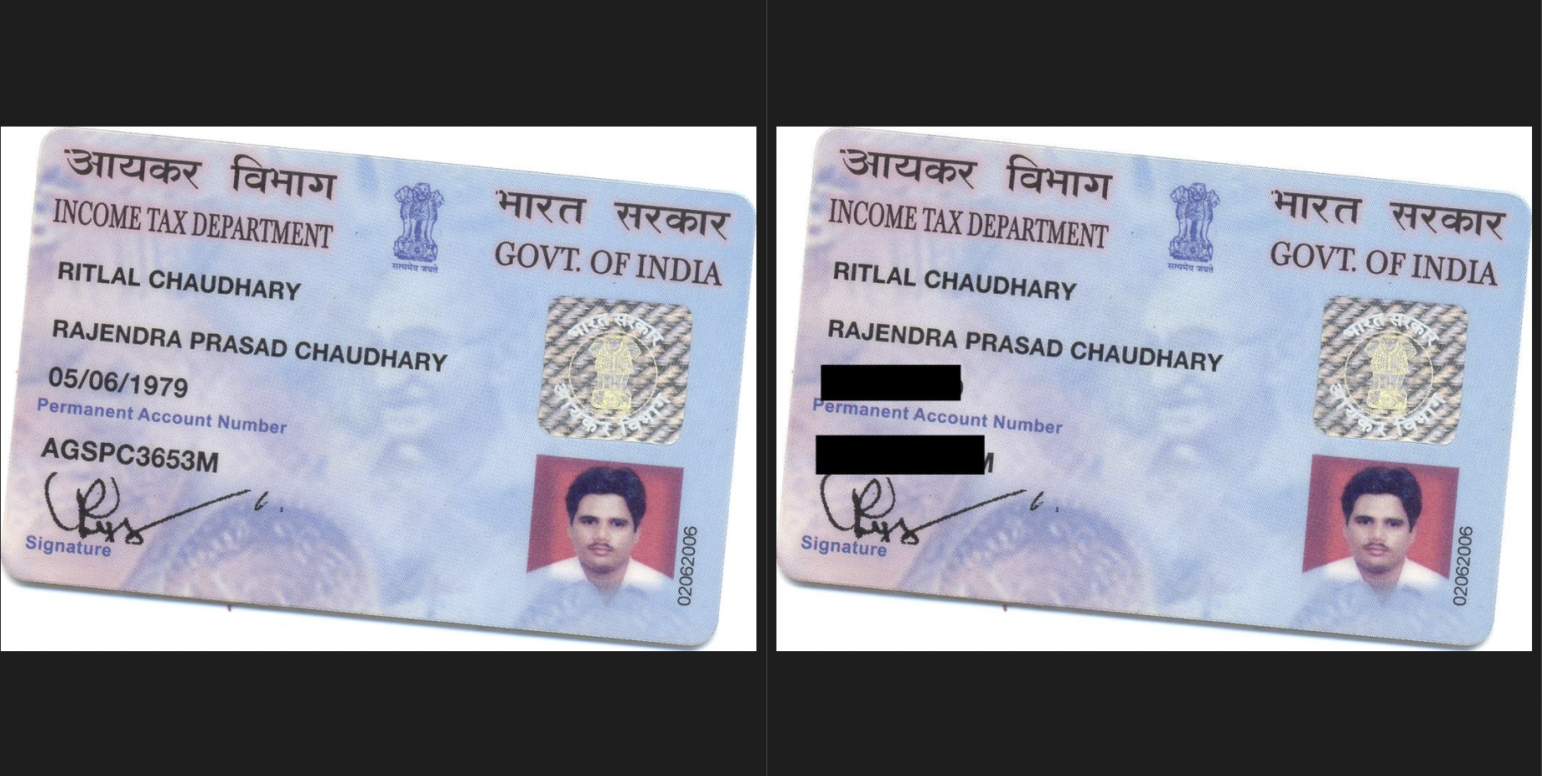
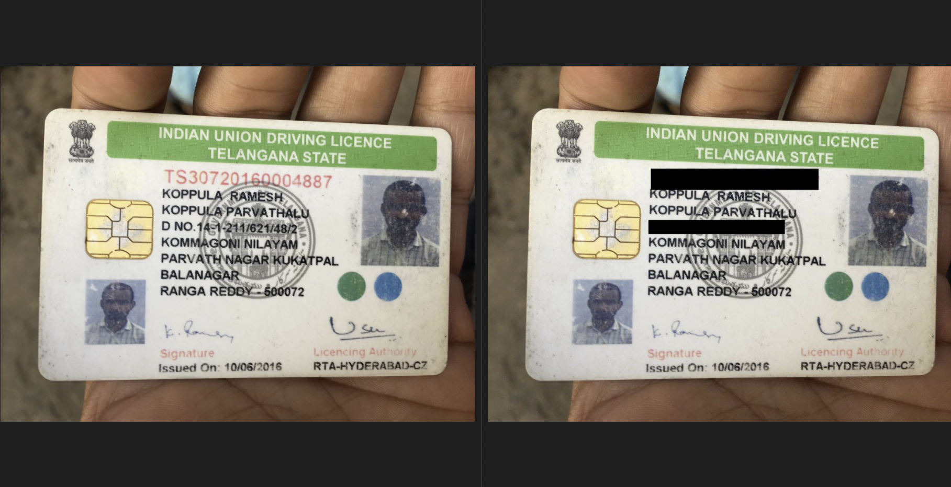
Masking

Slide 30
Summary
6
A write-up on why your application /solution should be considered

Slide 31
Why the solution should be considered?
The below points can be considered for my submission:
Works well for Both PDF and Images which contains noise.
AI Services to classify different documents using Hashing and Azure Form Recognizers without having many samples
Custom Processor Models to extract structured and unstructured text from the documents(Azure Computer Vision OCR) without large datasets with good confidence.
Signature Identification using custom model and azure form recognizers without and training.
Azure Functions for parallel processing of videos and scaling
Custom model(RetinaFace) to extract face and Azure Face Detection without any significant training.
Masking of text from KYC documents for each document – Aadhaar, Pan, Driving License, Passport
Azure Containers to store documents/images.

Slide 32
Scaling
7
Ability to scale-up in enterprise grade environment

Slide 33
The Solution Can be dockerised and deployed as a HTTP Azure function
AZURE Functions
100% Scalable
That’s a easy serverless way of running the solution on cloud
instances of the Functions host are dynamically added and removed based on the number of incoming events.
Automatically scales based on demand using pre-warmed workers, which run applications with no delay after being idle, runs on more powerful instances, and connects to virtual networks
Total success!

Slide 34
Video Demo
Please Find the Link of the video here.

Slide 35
THANKS!
Any questions?
You can find me at
sourabh.kumar.janghel@outlook.com
@sourabhkumarjanghel

Slide 36

WANT BIG IMPACT?
USE AZURE CLOUD!

